Slide 1
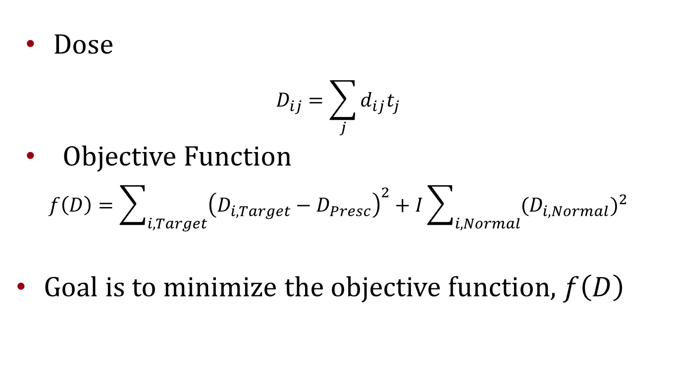
Dose and Objective Function
Dose
$$D_{ij}=\sum_{j}{d_{ij}t_{j}}$$
Objective Function
$$f\left(D\right)=\sum_{i,Target}{{\left(D_{i,Target}−D_{Presc}\right)}^{2}}+I\sum_{i,Normal}{({D_{i,Normal})}^{2}}$$
Goal is to minimize the objective function, $f\left(D\right)$

Slide 2
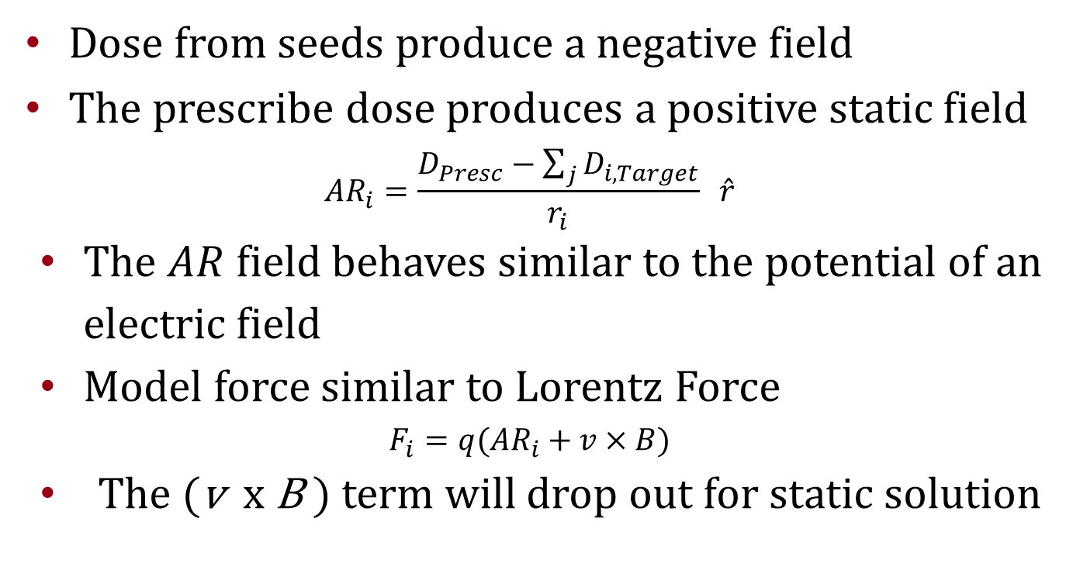
A-R Field (AR)
Dose from seeds produce a negative field
The prescribe dose produces a positive static field
$${AR}_{i}=\frac{D_{Presc}−\sum_{j}{D_{i,Target}}}{r_{i}} \hat{r}$$
The $AR$ field behaves similar to the potential of an electric field
Model force similar to Lorentz Force
$$F_{i}=q({AR}_{i}+v×B)$$
The (v x B ) term will drop out for static solution

